Slide 1
Detecting Network-Centric Attacks from Behavioral Telemetry
Rodger Scoggin
Johns Hopkins Capstone Project
2025

Slide 2

Agenda
Author Background
Problem & Motivation
Data & Features
Models and Selection Rationale
Evaluation: Time-Based Split
Key Results (ROC–AUC, Low-PFA ROC, PR/F1)
Operational View (PPV, Alerts)
SOTA Comparison
Limitations & Next Steps

Slide 3
Author Background
About
Director of Security Architecture & Engineering at Pathward leading a team of security professionals to transform enterprise security operations to a hybrid, cloud-native, internally run program
Over 30 years of experience spanning financial technology, consulting, professional services, and aerospace — including nearly a decade as an avionics engineer at NASA
Deep expertise in cloud security and architecture across AWS, Azure, and Microsoft 365; proven ability to design and implement security controls, policies, and standards at enterprise scale.
Former Senior Director at FIS (18 years) where I drove enterprise-class payment and transaction systems, introduced DevSecOps practices, and led large-scale platform migrations
As a co-founder of a multimedia startup acquired by FIS and as owner of MECO Consulting, I guided organizations on architecture, cloud adoption, and compliance
Recognized with multiple NASA honors and awards including the Silver Snoopy (NASA’s highest manned flight awareness award) for contributions to shuttle missions and payload operations

Slide 4
Problem & Motivation
Behavioral Signals
Low PFA
Encryption limits payload inspection but behavior remains observable
Objective: high PD/TPR at strict PFA (≤1%)
Behavioral telemetry enables decryption-free detection

Slide 5
Dataset Overview
Network Centric
Total sessions: 9,537
Train/Test (time-based): 6,675 / 2,862 (70/30)
10 features used for intrusion detection
Numeric: packet size, session duration, IP reputation, failed logins
Categorical: protocol_type, encryption_used, browser_type, unusual_time_access
Engineered: login_failure_rate, login_attempt_rate; future entity baselines

Slide 6
Model Selection Rationale
Model Considerations
Models Selected (project required one of each type noted)
Gradient Boosting (supervised classifier)
MLP (a small deep neural network 2-layer MLP)
Isolation Forest (unsupervised anomaly baseline)
Focus on operational constraints, data and label realities of SOC
GB produces scoring that meets SOC’s FPR budgets, runs fast on CPU, and exposes feature importances for sanity checks. Reliable supervised baseline for tabular NDR.
MLP can model smoother contours and guards against model-specific blind spots. It is easy to threshold and deploy in that training/inference are lightweight.
IF supports SOCs struggling with clean labels and rounds up the unsupervised requirement

Slide 7
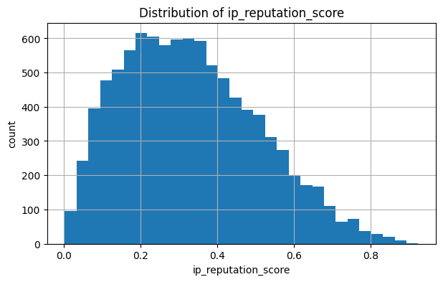
EDA
Data Engineering / Statistical Analysis
Target & splits: Moderately imbalanced but workable using a time-based train→test (70/30) split plus a host-disjoint check (~74/26 split on a smaller set)
Features: Mixed numeric (packet size, duration, reputation, failed logins) + categorical (protocol, encryption, browser, off-hours)
Engineering: Added login rates (failure/attempt) while guarded against divide-by-zero → 0.0
Signal checks: Clear separation for ip reputation↑, failed logins↑, off-hours=1, and extreme session duration
Interactions: Noted combos (e.g., off-hours × reputation, protocol × encryption) — later captured by GB
Outliers & ops focus: Kept extreme values (behaviorally meaningful) and reviewed distributions for ≤1% FPR thresholding

Slide 8
Preprocessing & Encoding
Data Processing
Exclude identifiers via whitelist
explicit feature_cols list with remainder='drop'
One-Hot encoding
Scale numerics
Uses handle_unknown='ignore’
Ensures unseen categories at test time don’t break
Standardize numeric features (z-score)
Required for MLP
Trees share the same pipeline for parity.
Impute missing values
numeric: median; categorical: most-frequent
Guarantees no NaNs hit the estimators

Slide 9
Train/Test: Time-Based Split
Evaluation
Train on historical window
test on a forward-in-time slice (70/30; 6,675 train / 2,862 test)
Primary metric: TPR at fixed FPR (PFA) budgets 0.1%, 0.2%, 0.5%, 1.0%
Confusion matrices / summary metrics shown here reflect default 0.5 thresholds
Calibrated cutoffs for strict FPR budgets are presented in ROC/PR plots.
ROC–AUC (95% bootstrap CI), Precision–Recall / F1, and a zoomed ROC for FPR ≤ 1%
Generalization check: repeated on a host-disjoint split

Slide 10
Results – Summary Metrics
Performance
GB: TPR≈0.765 @ FPR≈0.0019; AUC=0.889 (95% CI: 0.876–0.903)
MLP: TPR≈0.758 @ FPR≈0.0119; AUC=0.881 (95% CI: 0.866–0.895)
IF: TPR≈0.161 @ FPR≈0.1099; AUC=0.573 (95% CI: 0.552–0.594)
Note: As mentioned previously, values shown at default 0.5 thresholds and calibrated ≤1% FPR operating points shown in ROC/PR analysis. In addition, MLP exceeded the ≤1% FPR target (1.19%) as only Gradient Boosting satisfied the strict budget.

Slide 11
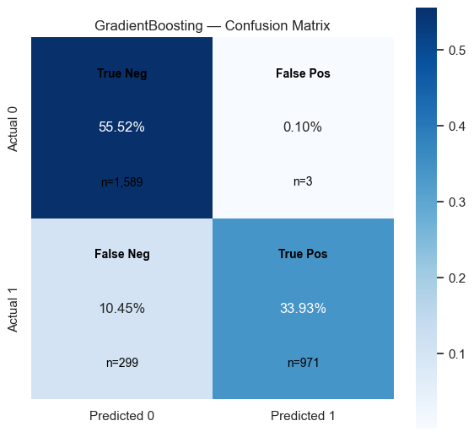
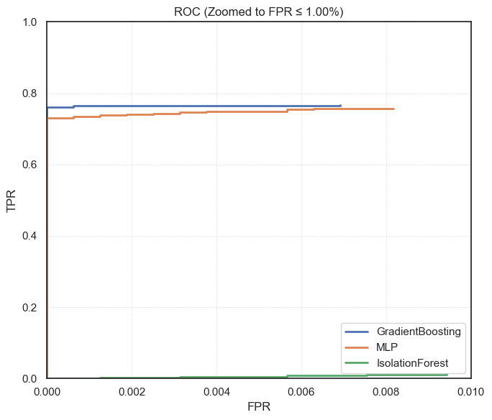
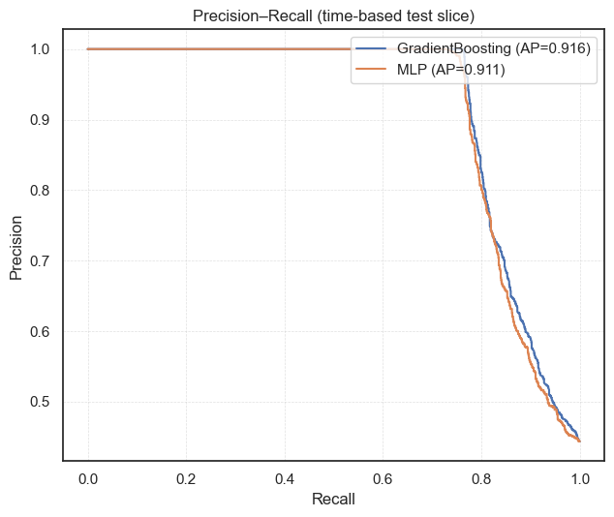
Results Analysis

Slide 12
Operational View: PPV & Alerts
Alert Budgeting
Convert FPR budgets
alerts/day given traffic volume N and prevalence p
Alerts/day = FPR·(1−p)·N + TPR·p·N
PPV = (TPR·p) / [TPR·p + FPR·(1−p)]
GB preserves high PPV at strict budgets
MLP trades precision for recall with higher FPR
High FPR means more alerts
Per-segment thresholds (user/host/role)
Drift monitoring to maintain PPV
Recalibrate as needed

Slide 13
Comparison to State of the Art
Industry NDR
Similar: behavioral focus, low-FP prioritization
Different: scope (platform vs. single model), learning mode, autonomous response
Positioning: lightweight detector to augment NDR/SIEM

Slide 14
Operationalize & Next Steps
Deployment
Production prevalence likely lower
Validate PPV/alerts live
Add sequence/rolling features; segment-wise tuning
Shadow deploy → drift monitoring → periodic recalibration

